Slide 1

Chapter 20
Types of Risks Incurred by Financial Institutions
© McGraw Hill LLC. All rights reserved. No reproduction or distribution without the prior written consent of McGraw Hill LLC.

Slide 2
Risks at Financial Institutions
A major objective of F I management is to increase the F I’s returns for its owners, but increased returns typically come at the cost of increased risk:
Credit risk.
Liquidity risk.
Interest rate risk.
Market risk.
Off-balance sheet risk.
Foreign exchange risk.
Country or sovereign risk.
Technology risk.
Operational risk.
Digital disruption and fintech risk.
Insolvency risk.

Slide 3
Risks Faced by Financial Institutions 1
Credit risk—the risk that promised cash flows from loans and securities held by F I’s may not be paid in full.
Liquidity risk—the risk that a sudden and unexpected increase in liability withdrawals may require an F I to liquidate assets in a very short period of time and at low prices.
Interest rate risk—the risk incurred by an F I when the maturities of its assets and liabilities are mismatched and interest rates are volatile.
Market risk—the risk incurred in trading assets and liabilities due to changes in interest rates, exchange rates, and other asset prices.
Off-balance-sheet risk—the risk incurred by an F I as the result of its activities related to contingent assets and liabilities.
Foreign exchange risk—the risk that exchange rate changes can affect the value of an F I's assets and liabilities denominated in foreign currencies.
Notes:
Table 20–1 presents a brief definition of each of the various risks facing FIs.

Slide 4
Risks Faced by Financial Institutions 2
Country or sovereign risk—the risk that repayments by foreign borrowers may be interrupted because of interference from foreign governments or other political entities.
Technology risk—the risk incurred by an F I when its technological investments do not produce anticipated cost savings.
Operational risk—the risk that existing technology or support systems may malfunction, that fraud that impacts the F I's activities may occur, and/or that external shocks such as hurricanes and floods may occur.
Digital disruption and fintech risk—the risk that fintech firms could disrupt business of financial services firms in the form of lost customers and lost revenue.
Insolvency risk—the risk that an F I may not have enough capital to offset a sudden decline in the value of its assets relative to its liabilities.

Slide 5
Credit Risk at F I’s 1
Credit risk is the risk that the promised cash flows from loans and securities held by F I’s may not be paid in full.
Virtually all types of F I’s face this risk, but F I’s that make loans or buy bonds with long maturities are more exposed than are F I’s that make loans or buy bonds with short maturities.
Even as losses due to credit risk increase, F I’s continue to willingly give loans because they charge a rate of interest on a loan that compensates for the risk of the loan
  Important element in the credit risk management process is pricing.
Managerial (monitoring) efficiency and credit risk management strategies directly affect the returns and risks of the loan portfolio.

Slide 6
Credit Risk at F I’s 2
Advantage that F I’s have over individual investors is their ability to diversify credit risk exposures from a single asset by exploiting the law of large numbers in their asset investment portfolios.
Diversification reduces firm-specific credit risk, the risk of default for the borrowing firm associated with the specific types of project risk taken by that firm.
For Example, risk specific to holding the bonds or loans of G M.
Diversification does not reduce systemic credit risk, the risk of default associated with general economy-wide or macro-conditions affecting all borrowers.
For Example, an economic recession.

Slide 7
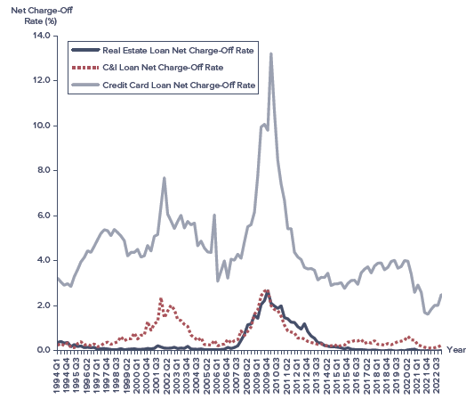
Charge-Off Rates for Commercial Bank Lending Activities
Sources: F D I C, Quarterly Banking Profile, various issues, www.fdic.gov
Access the text alternative for slide images.
Notes:
The effects of credit risk are evident in Figure 20–1, which shows commercial bank charge-off (or write-off) rates (loans charged off as a percentage of total loans) for various types of loans between 1994 and 2022.
Notice, in particular, the high rate of charge-offs experienced on credit card loans throughout this period.
Credit card charge-offs by commercial banks increased persistently from the mid-1980s until late 1993 and again from 1995 through early 1998.
By 1999, credit card charge-offs leveled off, and they even declined after 1999.
With the downturn in the U.S. economy and an impending change in bankruptcy laws making it more difficult to declare bankruptcy, credit card charge-offs rose rapidly in 2001 and remained high through 2004.
Note particularly that in October 2005, the Bankruptcy Reform Act was signed into law. This act makes it more difficult for consumers to declare bankruptcy. As a result, there was a surge in bankruptcy filings in the summer and early fall of 2005 just before the new rules went into effect and a huge drop-off in bankruptcy filings just after the enactment of the new rules.
The financial crisis of 2008–2009 and the resulting economic recession produced a huge surge in credit card charge-off rates, which rose to an all-time high of 13.21 percent in March 2010. Despite these losses, credit card loans (including unused balances) extended by commercial banks continued to grow, from $160.8 billion in March 1994 to $421.5 billion in December 2022.
As of December 2022, credit card loans extended by commercial banks totaled $1,009.4 billion.

Slide 8
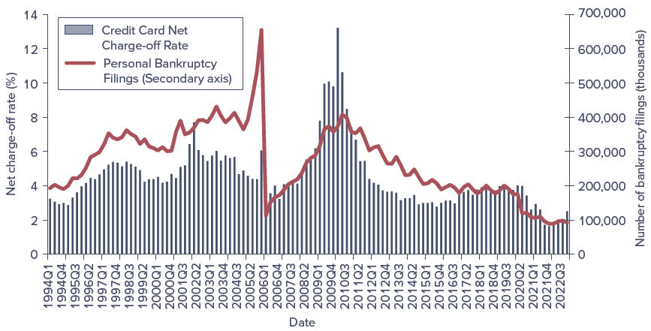
Credit Card Loss Rates and Personal Bankruptcy Filings
Sources: F D I C, Quarterly Banking Profile, various issues, www.fdic.gov
Access the text alternative for slide images.
Notes:
The effects of credit risk are evident in Figure 20–2, which shows commercial bank charge-off (or write-off) rates (loans charged off as a percentage of total loans) for various types of loans between 1994 and 2022.

Slide 9
Impact of Credit Risk on an F I’s Equity Value
Example 20.1: Impact of Credit Risk on an F l's Equity Value.
Consider an F I with the following balance sheet:
Cash | $ 20m
Gross loans | 80m
 | $100m
Deposits | $ 90m
Equity (net worth) | 10m
 | $100m
Suppose that the managers of the F I recognize that $5 million of its $80 million in loans is unlikely to be repaid due to an increase in credit repayment difficulties of its borrowers. Eventually, the F I's managers must respond by charging off or writing down the value of these loans on the F l's balance sheet. This means that the value of loans falls from $80 million to $75 million, an economic loss that must be charged off against the stockholder's equity capital or net worth (that is, equity capital falls from $10 million to $5 million). Thus, both sides of the balance sheet shrink by the amount of the loss:
Cash |  | $ 20m
Gross loans | 80m
Less: Loan loss | −5m
Loans after charge-off |  | 75m
 |  | $95m
Deposits | $ 90m
Equity after charge-off | 5m
 | $95m

Slide 10
Liquidity Risk
Liquidity risk is the risk that a sudden and unexpected increase in liability withdrawals may require an F I to liquidate assets in a very short period and at low prices.
On the asset side of the balance sheet, loan requests and the exercise by borrowers of their loan commitments and other credit lines causes liquidity risk.
  Most liquid asset of all is cash.
To meet the demand for cash by liability holders, F I’s must either liquidate assets or borrow additional funds.
When all, or many, F I’s face abnormally large cash demands, the cost of purchased of borrowed funds rises and the supply of such funds becomes restricted.
  F I’s may have to sell some of their less liquid assets to meet the withdrawal demands, resulting in serious liquidity risk.

Slide 11
Impact of Liquidity Risk on Equity Value 1
Before the Withdrawal
After the Withdrawal
Assets |  | Liabilities/Equity
Cash assets | $ 10 | Deposits | $ 90
Nonliquid assets | 90 | Equity | 10
 | $100 |  | $100
Assets |  | Liabilities/Equity
Cash assets | $ 0 | Deposits | $ 75
Nonliquid assets | 80 | Equity | 5
 | $80 |  | $80
Example: Impact of Liquidity Risk on an F l’s Equity Value.
Consider the simple F I balance sheet above. Before deposit withdrawals, the F I has $10 million in cash assets and $90 million in nonliquid assets (such as small business loans). These assets were funded with $90 million in deposits and $10 million in owner's equity. Suppose that depositors unexpectedly withdraw $15 million in deposits (perhaps due to the release of negative news about the profits of the F l) and the F I receives no new deposits to replace them.

Slide 12
Impact of Liquidity Risk on Equity Value 2
To meet these deposit withdrawals, the F I first uses the $10 million it has in cash assets and then seeks to sell some of its nonliquid assets to raise an additional $5 million in cash. Assume that the F I cannot borrow any more funds in the short-term money markets, and because it cannot wait to get better prices for its assets in the future (as it needs the cash now to meet immediate depositor withdrawals), the F I has to sell any nonliquid assets at 50 cents on the dollar. Thus, to cover the remaining $5 million in deposit withdrawals, the F I must sell $10 million in nonliquid assets, incurring a loss of $5 million from the face value of those assets. The F I must then write off any such losses against its capital or equity funds. Since its capital was only $10 million before the deposit withdrawal, the loss on the fire sale of assets of $5 million leaves the F I with $5 million.

Slide 13
Interest Rate Risk 1
Interest rate risk is the risk incurred by an F I when the maturities of its assets and liabilities are mismatched and interest rates are volatile.
Asset transformation involves an F I buying primary securities/assets and issuing secondary securities/liabilities to fund the assets.
  Primary securities that F I’s purchase often have maturity characteristics different from the secondary securities that F I’s sell.
Refinancing risk is the risk that the cost of rolling over or reborrowing funds will rise above the returns being earned on asset investments.
  Type of interest rate risk that occurs when an F I holds longer-term assets relative to liabilities.
By holding shorter-term assets relative to its liabilities, an F I faces reinvestment risk, the risk that the returns on funds to be reinvested will fall below the cost of funds.

Slide 14
Interest Rate Risk 2
Price risk is the risk that the price of the security will change when interest rates change.
Rising (falling) interest rates increase (decrease) the discount rate on future asset or liability cash flows and reduce (increase) the market price or present value of that asset or liability.
Mismatching maturities by holding longer-term assets than liabilities means that when interest rates rise, the economic or present value of the F I’s assets falls by a larger amount than its liabilities.
F Is can seek to hedge or protect themselves against interest rate risk by matching the maturity of their asset and liabilities, but this strategy is not necessarily consistent with an active asset transformation function for F I’s.
Matching maturities hedges interest rate risk only in a very approximate rather than complete fashion.

Slide 15
Market Risk 1
Market risk is the risk incurred in trading assets and liabilities due to changes in interest rates, exchange rates, and other asset prices.
Closely related to interest rate and foreign exchange risk.
Adds another dimension of risk: trading activity.
  Market risk is the incremental risk incurred by an F I when interest rate and foreign exchange risks are combined with an active trading strategy, especially on that involves short trading horizons such as a day.
F I’s trading portfolio can be differentiated from its investment portfolio on the basis of time horizon and liquidity.
  Trading portfolio contains assets, liabilities, and derivative contracts that can be quickly bought or sold on organized financial markets, whereas investment portfolio contains assets and liabilities that are relatively illiquid and held for longer periods.

Slide 16
The Investment (Banking) Book and Trading Book of a Commercial Bank
 | Assets | Liabilities
Banking book | Loans | Capital
 | Other illiquid assets | Deposits
Trading book | Bonds (long) | Bonds (short)
 | Commodities (long) | Commodities (short)
 | F X (long) | F X (short)
 | Equities (long) | Equities (short)
 | Derivatives* (long) | Derivatives* (short)
*Derivatives are off-balance-sheet.
Notes:
Table 20–3 shows a hypothetical breakdown between banking book and trading book assets and liabilities. Note that capital produces a cushion against losses on either the banking or trading books (see Chapter 23).
As can be seen, the banking book contains the majority of loans and deposits plus other illiquid assets. The trading book contains long and short positions in instruments such as bonds, commodities, foreign exchange, equities, and derivatives.

Slide 17
Market Risk 2
Traditional roles of many F I’s have changed in recent years.
For large commercial banks such as money center banks, decline in income from traditional deposit taking and lending activities has been matched by an increased reliance on income from trading.
Decline in underwriting and brokerage income for large investment banks has also been met by more active and aggressive trading in securities, derivatives, and other assets.
Mutual fund managers, who actively manage their asset portfolios, are also exposed to market risk.
F I’s are concerned about fluctuations in value, or value at risk (V A R) of their trading account assets and liabilities for periods as short as one day – so-called daily earnings at risk (D E A R) – especially if such fluctuations pose a threat to their solvency.

Slide 18
Off-Balance-Sheet Risk 1
Off-balance-sheet (O B S) risk is the risk incurred by an F I as the result of activities related to contingent assets and liabilities.
In 2022, commercial banks had $23.6 trillion in on-balance-sheet items, while the face or notional value of their off-balance-sheet derivative items was $191.0 trillion.
  O B S activities do not appear on an F I’s current balance sheet since it does not involve holding a currency primary claim (asset) or the issuance of a current secondary claim (liability).
O B S activities involve the creation of contingent assets and liabilities that give rise to their potential placement in the future on the balance sheet.
  Contingent assets and liabilities are assets and liabilities off the balance sheet that potentially can produce positive or negative future cash flows for an F I.

Slide 19
Valuation of an F I’s Net Worth with and without Consideration of O B S Activities
Panel A: Traditional valuation of an F l’s net worth.
Market value of assets (A) | 100
 | 100
Market value of liabilities (L) | 90
Net worth (E) | 10
 | 100
Panel B: Valuation of an F l’s net worth with on- and off-balance-sheet activities valued.
Market value of assets (A) | 100
Market value of contingent assets (C A) | 50
 | 150
Market value of liabilities (L) | 90
Net worth (E) | 5
Market value of contingent liabilities (C L) | 55
 | 150
Notes:
Consider Table 20–4. In Panel A, the value of the FI’s net worth (E) is calculated in the traditional way as the difference between the market values of its on-balance-sheet assets (A) and liabilities (L). Under this calculation, the market value of the stockholders’ equity stake in the FI is 10 and the ratio of the FI’s capital to assets (or capital-to-assets ratio) is 10 percent.
A more accurate picture of the FI’s economic solvency should consider the market values of both its on-balance-sheet and OBS activities (Panel B of Table 20–4). Specifically, the FI manager should value contingent or future asset and liability claims as well as current assets and liabilities.
See Example 20-5 for additional details.

Slide 20
Off-Balance-Sheet Risk 2
More attention has been drawn to the O B S activities of banks, especially large ones, as opposed to small depository institutions or insurers.
Issuing a letter of credit (L C) is an O B S activity.
L C is a credit guarantee issued by an F I for a fee on which payment is contingent on some future event occurring, most notably default of the agent that purchases the L C.
Other examples of O B S activities are collateralized mortgage obligations (C M O’s), loan commitments by banks, mortgage servicing contracts by depository institutions, and positions in forwards, futures, swaps, and other derivative securities by almost all large F I’s.
Ability to earn fee income while not loading up or expanding the balance sheet has become an important motivation for F I’s to pursue O B S business.
Notes:
OBS activity is not risk free. Off-balance-sheet securities played a prominent role in the U.S. subprime mortgage crisis.

Slide 21
Foreign Exchange Risk 1
Foreign exchange (F X) risk is the risk that exchange rate changes can affect the value of an F I’s assets and liabilities denominated in foreign currencies.
U S pension funds that held approximately 5% of their assets in foreign securities in the early 19 90’s now hold close to 24% of their assets in foreign securities.
Returns on domestic and foreign direct investments and portfolio investments are not perfectly correlated for two reasons:
Underlying technologies of various economies differ, as do the firms in those economies.
Exchange rate changes are not perfectly correlated across countries.
F I’s expand globally through acquiring foreign firms or opening new branches in foreign countries, as well as investing in foreign financial assets.

Slide 22
Foreign Exchange Risk 2
A net long position in a foreign currency involves an F I holding more foreign assets than liabilities.
F I loses when foreign currency falls relative to the U S dollar.
F I gains when foreign currency appreciates relative to the U S dollar.
A net short position in a foreign currency involves an F I holding fewer foreign assets than liabilities.
F I gains when foreign currency falls relative to the U S dollar.
F I loses when foreign currency appreciates relative to the U S dollar.
F I is fully hedged only if we assume that it holds foreign assets and liabilities of exactly the same maturity.

Slide 23
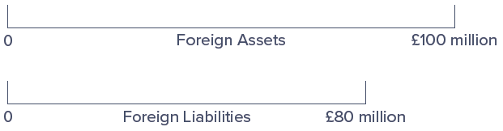
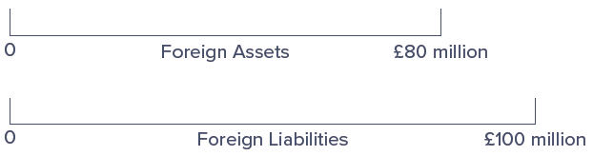
Foreign Asset and Liability Positions
Net Long Asset Position in Pounds.
Net Short Asset Position in Pounds.
Access the text alternative for slide images.
Notes:
See Figure 20–3. In this case, the U.S. FI is net long £20 million in British assets. That is, it holds more foreign assets than liabilities.
Instead, the FI could have £20 million more foreign liabilities than assets. In this case, it would be holding a net short position in foreign assets, as shown in Figure 20–4. Under this circumstance, the FI is exposed to foreign exchange risk if the pound appreciates against the dollar over the investment period.

Slide 24
Sovereign Risk 1
Country, or sovereign, risk is the risk that repayments from foreign borrowers may be interrupted because of interference from foreign governments.
Differs from the type of credit risk that is faced by an F I that purchases domestic assets, such as the bonds and loans of domestic corporations.
  With domestic defaults, F I’s usually have some recourse through bankruptcy courts (that is, F I’s can recoup some of their losses when defaulted firms are liquidated or restructured).
Foreign corporations may be unable to pay principal and interest even if they desire to do so.
  Foreign governments may limit or prohibit debt repayment due to foreign currency shortages or adverse political events.

Slide 25
Sovereign Risk 2
In the event of restrictions or outright prohibitions on the payment of debt obligations by sovereign governments, the F I claimholder has little if any recourse to local bankruptcy courts or to an international civil claims court.
Measuring sovereign risk includes an analysis of macroeconomic issues, such as the following:
Trade policy;
Fiscal stance (deficit or surplus) of the government;
Government intervention in the economy;
Its monetary policy;
Capital flows and foreign investment;
Inflation; and,
Structure of its financial system.
Notes:
For example, in 2001 the government of Argentina, which had pegged its peso to the dollar on a one-to-one basis since the early 1990s, had to default on its government debt largely because of an overvalued peso and the adverse effect this had on its exports and foreign currency earnings. In December 2001 Argentina ended up defaulting on $130 billion in government-issued debt, and in 2002 it passed legislation that led to defaults on $30 billion of corporate debt owed to foreign creditors. Argentina’s economic problems continued into the 2000s and even the 2010s. In September 2003, it defaulted on a $3 billion loan to the IMF, and in early 2018 Argentina was still asking for debt payment adjustments.

Slide 26
Technology and Operational Risk
Technology risk is the risk incurred by an F I when its technological investments do not produce anticipated cost savings.
Major objectives of technological expansion are to lower operating costs, increase profits, and capture new markets for an F I.
Operational risk is the risk that existing technology or support systems may malfunction or break down.
Not exclusively the result of technological failure.
Other sources of operational risk can result in direct costs, indirect costs, and opportunity costs that reduce an F I’s profitability and market value.
Notes:
Technology and operational risks are closely related and in recent years have caused great concern to FI managers and regulators alike.

Slide 27
Digital Disruption and Fintech Risk
Digital Disruption and Fintech risk is the risk that fintech firms could disrupt business of financial services firms in the form of lost customers and lost revenue.
Broader and wider ranging than technology risk.
Fintech services such as cryptocurrencies (for example, bitcoin) and blockchain provide a system that supports the exchange of value between two parties unknown to each other in a swift and effective way, without the need for financial intermediaries.
Largest fintech companies include the following:
  SoFi, an online personal finance company;
  Transferwise, an international money transfer provider; and,
  Credit Karma, a platform that provides credit scores to users and also serves as a portal for people to search and apply for various financial services, like loans, credit cards, and insurance.

Slide 28
Insolvency Risk
Insolvency risk is the risk that an F I may not have enough capital to offset a sudden decline in the value of its assets relative to its liabilities.
Insolvency risk is a consequence or an outcome of one or more of the risks previously described:
  Interest rate, market, credit, O B S, technological, digital disruption and fintech, foreign exchange, sovereign, and liquidity risk.
Generally, the more equity capital to borrowed funds an F I has (that is, the lower its leverage), the better able it is to withstand losses due to risk exposures such as adverse liquidity changes, unexpected credit losses, and so on.
Both regulators and managers focus on capital adequacy as a key measure of an F I’s ability to remain solvent and grow in the face of a multitude of risk exposures.

Slide 29
Other Risks and Interactions Among Risks
All of the previously defined risks are interdependent.
Each risk and its interaction with other risks ultimately affects solvency risk.
Various other risks also impact F I’s profitability and risk exposure:
Discrete, or event-type, risks:
  Sudden change in taxation.
  Changes in regulatory policy, including lifting the regulatory barriers to lending or to entry or on products offered.
  Sudden and unexpected changes in financial market conditions due to war, revolutions, or sudden market collapse.
  Theft, malfeasance, and breach of fiduciary trust.
Macroeconomic risks:
  Increased inflation and inflation volatility.
  Unemployment.

